Slide 1
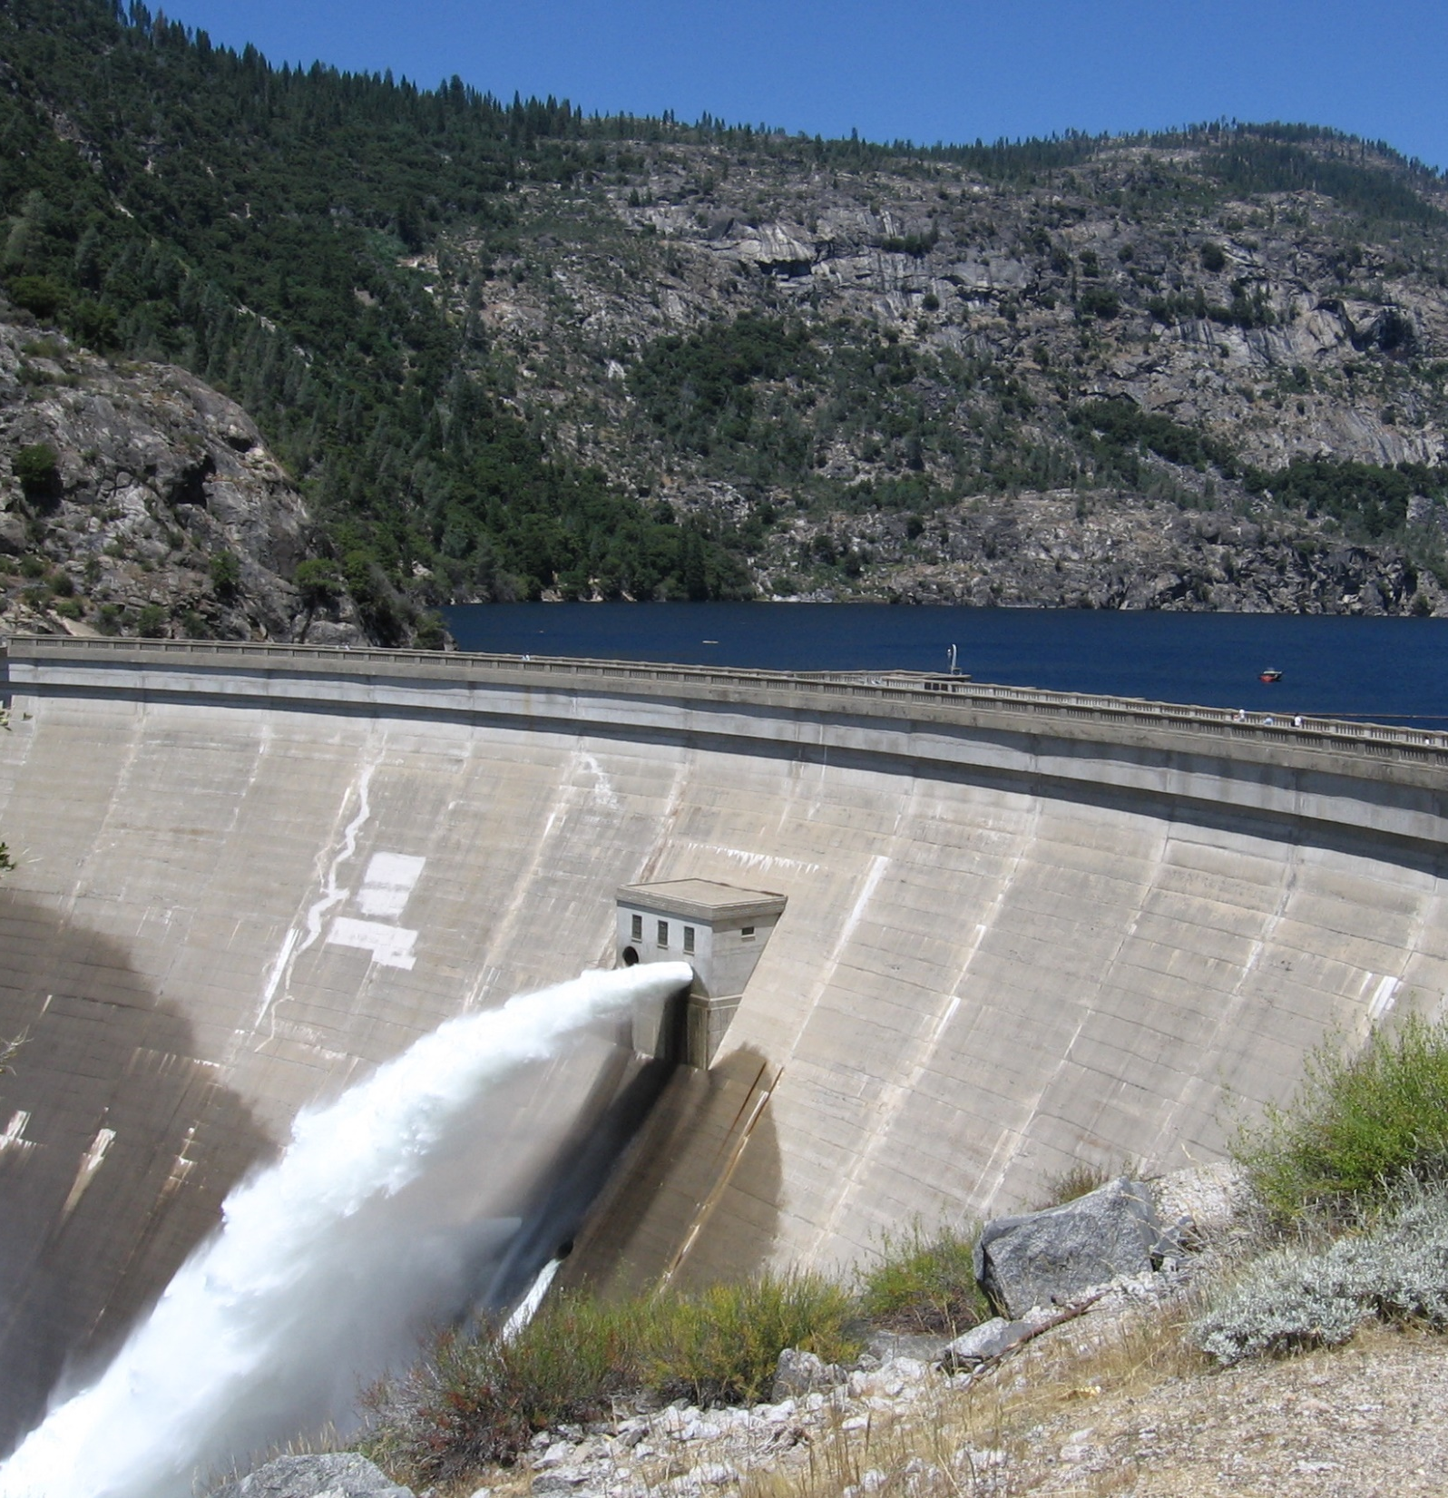
Federal Infrastructure Bank
Financing
U. S. Infrastructure Without Gov’t. Funding
October 2023

Slide 2
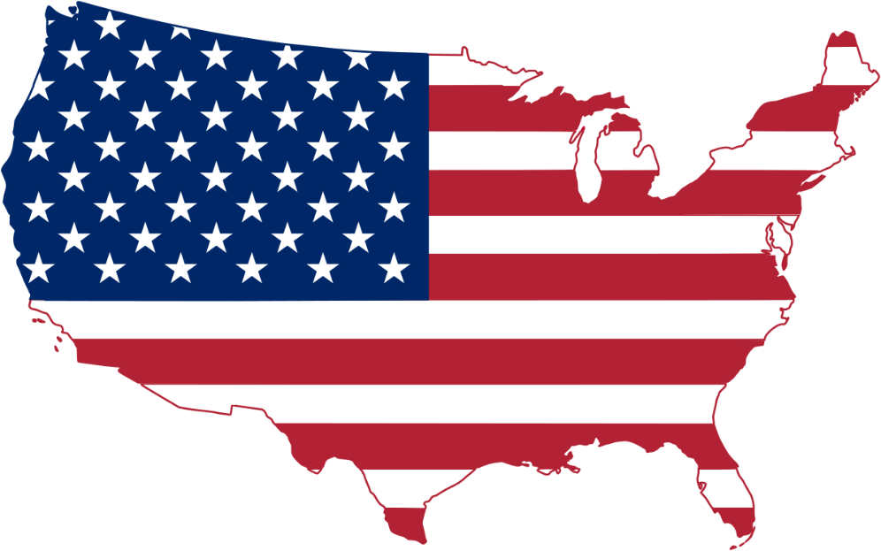
Three Points for Discussion
Three Points today:
1 – The Past : We must reverse the Long-Term Secular decline of the last 60 years or more.
2 – The Present: We must rebuild the U. S. economy now from the ground up with Intelligent Infrastructure.
3 – The Future: The Federal Infrastructure Bank will be a major source of financing for this infrastructure boom.

Slide 3
The Answer:
The Federal Infrastructure Bank, Inc. will provide LIQUIDITY to infrastructure finance.
Plus all other private sources, i. e. Muni Bonds, Private Equity, Banks, Non-Banks, Insurance Cos., Infrastructure Funds, Pension Funds, etc.
Pledged Revenue, Collateral, Guarantees
How to Finance US Infrastructure
Without Gov’t Funding?

Slide 4
The Past

Slide 5
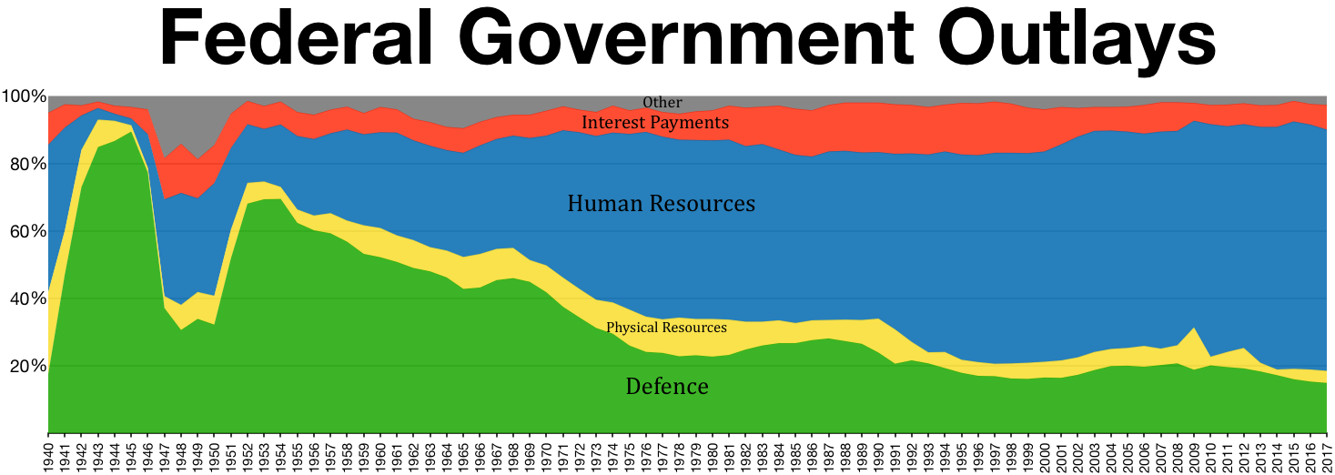
Butter vs. Guns

Slide 6
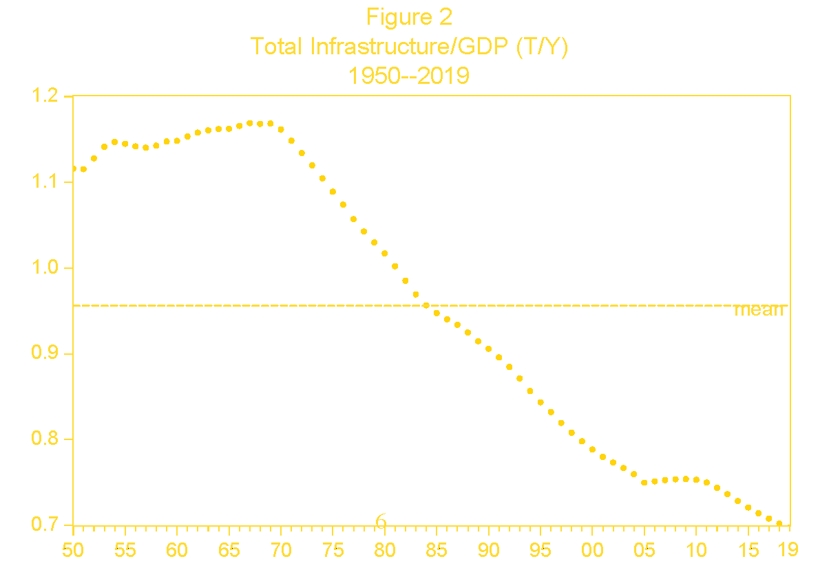
Since WW2

Slide 7
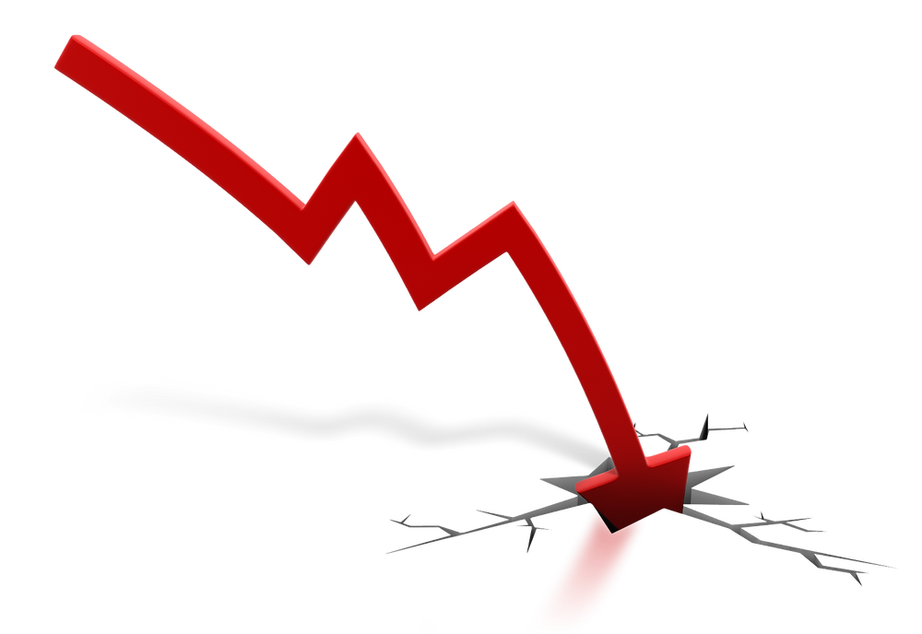
The US in Long Term Secular Decline
Federal Debt is 95% of GDP in 2023
Total Federal Debt including social commitments is 160% of GDP
When FDR became President in 1933, the Federal Debt was $22 billion, about 18% of GDP. He had the financial fire power to fight the Great Depression and WWII.
Today, we do not. The next President will be ham-strung by debts and obligations that will limit our national ability to respond to crises.
The FIB will help reverse this decline at no cost to Government.

Slide 8
Fitch rating is AA+
S&P rating is AA+
Moody’s – a weak AAA
This means higher interest costs for years to come.
USG will not be a major infrastructure player for decades. No money.
States and Cities are in the same boat.
Why is USA downgraded?
USG Credit Downgraded

Slide 9
The Present

Slide 10
The New Turning Point for the US Economy
2023 – 2024 will be the new turning point for the US economy and our role in the world.
We must rebuild our economy from the bottom up, and infrastructure is the foundation of all economic activity.
New policies and incentives to promote manufacturing and infrastructure.
The Federal Infrastructure Bank will be the critical player in this renewal and rebuilding.
Butter does not win wars, commercial or military.

Slide 11
Four Pillars of the US Economy
The US Federal Reserve System – 1913
The Farm Credit System - 1916
The Federal Home Loan Bank System – 1932
The Federal Infrastructure Bank Act of 2023, H. R. 490 (to be chartered and established in 2023/2024)

Slide 12
Muni Bonds - $384 billion issued in 2022, down $100 billion from 2021, due to rising interest rates.
Investors are mostly tax driven and retail. 80% plus of funds raised are for maintenance.
Muni Bonds don’t trade in size. Not a liquid market.
Decisions are made by politicians and political entities.
“If they would not build and finance at 2%, they will not at 5% or 6% interest rates.” Political and rate decisions are a major impediment.
FIB will lend to and with State Infrastructure Banks. FIB will buy loan packages from SIBs and be a co-lender with them.
FIB will issue $1 trillion in short-, medium- and long-term infrastructure bonds during the next 8 to 10 years and significantly more thereafter.
Muni Bonds are not the Answer

Slide 13
Private Equity raises about $70 billion per year from institutions with funds committed for fixed terms. Limited liquidity.
PE ROR requirements are 12% to 18%.
They are structured finance experts and need large scale projects.
Commercial Banks are short to medium term lenders. Their loans are mostly held on their books.
Local and Community Banks do not make infrastructure loans. Bank Qualified Market is insignificant. Fed keeps no records.
Some large banks, like JPM, arrange infrastructure financings. Muni Finance vs. Structured Finance Depts.
Private Equity and Banks are Limited

Slide 14
No state handles more of America’s cargo than Texas.
Texas infrastructure has led to it being the nation’s top exporter for 21 consecutive years.
The state exported more than $485 billion in goods in 2022, ahead of the combined exports of California, New York and Louisiana.
Without top infrastructure, businesses cannot thrive.
Texas Leads in
Infrastructure

Slide 15
The Future

Slide 16
Expect the Un-expected.
The answers of the past will not be the solutions of the future.
Intelligent Infrastructure will replace Dumb Infrastructure.
Most infrastructure will be user paid, plus related revenue sources.
Regulatory environments, Local jurisdictions, PUC/State mandates.
Private Money will lead.
The Future

Slide 17
Inflation and Interest Rates will remain high but will return to LT averages.
China has been exporting deflation for the last 40 years.
China will now export Inflation thru higher wages and costs at home.
China and the USA will diverge.
The Fed will have little control over inflation.
The Future for the U. S. Economy - 1

Slide 18
Interest rates will eat up 30% to 50% of the USG budget for decades.
Work at home will require less urban infrastructure, unless ….
US must onshore manufacturing, esp. steel and all infrastructure, which must be done locally.
Tax incentives must offset increased user fees to be acceptable to voters.
The Future for the U. S. Economy - 2

Slide 19
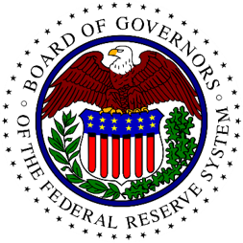
The Federal Infrastructure Bank, Inc.
The FIB will the primary source of financing for US infrastructure projects.
It will be the engine of change to infuse $1 -$5 trillion into US infrastructure in 10+ years, and $trillions thereafter each year for the next 50 to 100 years.
It will create a new class of Infrastructure Bonds (I-Bonds), similar to Mortgage-Backed Securities (MBS), to give depth and LIQUIDITY to financial markets.
FIB will be the clearinghouse for infrastructure finance and will be the “Lender of First Resort”. Short and Medium Term Lender.

Slide 20
Provide liquidity.
Help standardize infrastructure finance.
Develop the market for Infrastructure Bonds.
Syndicate infrastructure loans nationwide.
Wholesale Infrastructure Bank
Clearing House for Infrastructure Loans
Be Profitable.
Purpose of the FIB

Slide 21
FIB will be a wholesale lender and clearing house for infrastructure projects nationwide and will co-lead as an originator for certain large projects .
Letters of Credit, Variable Rate Deposit Notes, Collateralized Loan Obligation.
Finance early-stage projects with State and Local guarantees, plus a DOT TIFIA or other such takeout, as a warehouse or interim lender.
Syndicate infrastructure loans nationwide.
FIB Financing Tools -1

Slide 22
Aggregate Loan Proposals into a portfolio of loans with sufficient collateral and pledged revenue to secure a AAA Credit Rating.
FIB will be a Long-Term Lender to match Long-Term project needs.
Co-lender on large projects like the NY/NJ Gateway Tunnel project.
Asset-backed bonds or notes, secured by pledged revenue, collateral and guarantees.
Credit enhancement through insurance, guarantees and additional collateral.
FIB Financing Tools - 2

Slide 23
FIB will be a consistent and reliable source of financing, not dependent on government funding or annual appropriations. (But some repayment and take outs may depend on these sources.)
Revive the State Infrastructure Banks – 5 are active; 30 are dormant.
CBO - FIB could issue collateralized bond obligations backed by corporate bonds financing infrastructure projects.
CLO - FIB could issue collateralized loan obligations backed by bank infrastructure loans. (Dodd Frank Capital requirements will be a factor.)
FIB Financing Tools - 3

Slide 24
The FIB will finance Intelligent Infrastructure, not the old and Un-Intelligent Infrastructure.
Why?
Intelligent Infrastructure projects will be a good credit risk, because they will generate cash flow and have good assets as collateral. Managements will attract the best and brightest people.
Intelligent Infrastructure is the future. The FIB is a long-term lender, so we must finance projects that are the future , not the past.
Intelligent Infrastructure is the Answer

Slide 25
more information, contact:
William T. Nolan
President, Infra-Bk, LLC
(845) 724-3237
wtnolan2@devhold.com
Website: www.infra-bk.com
Video: https://youtu.be/WzkEilkrJOo

